Slide 1
Using the Kinect in Processing
David Meredith
Aalborg University

Slide 2
Some sources
Daniel Shiffman’s “Getting started with Kinect and Processing” tutorial
http://www.shiffman.net/p5/kinect/

Slide 3
Installing on Mac OS X
Plug the Kinect into the computer via the USB and plug its power supply into the socket
Download openkinect.zip from
http://www.shiffman.net/p5/libraries/openkinect/openkinect.zip
Save the openkinect.zip to the libraries folder inside your Processing sketchbook folder
Extract openkinect.zip – this should create a folder called openkinect inside your libraries folder
Start (or restart) Processing

Slide 4
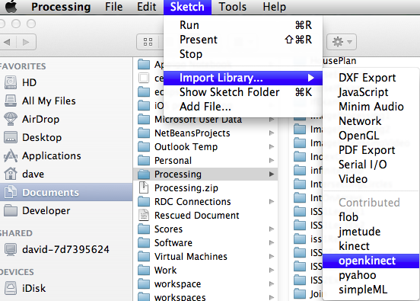
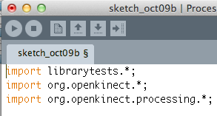
Adding the Kinect libraries to your sketch
Choose Import Library > openkinect from the Sketch menu
This inserts the relevant package import lines into the beginning of your sketch

Slide 5
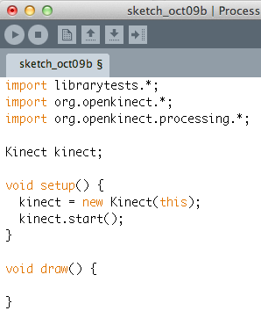
Declaring and starting a Kinect object
Declare a Kinect object
Initialize the Kinect object
Start the Kinect object

Slide 6
Four types of data coming from the Kinect
RGB image from the kinect camera as a PImage
Grayscale image from the IR camera as a PImage
Grayscale image in which each pixel’s brightness value represents depth (distance from Kinect)
Brighter = Closer
Raw depth data
11-bit numbers between 0 and 2047 stored as an array of ints ( int[] )

Slide 7
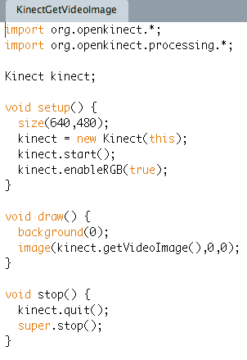
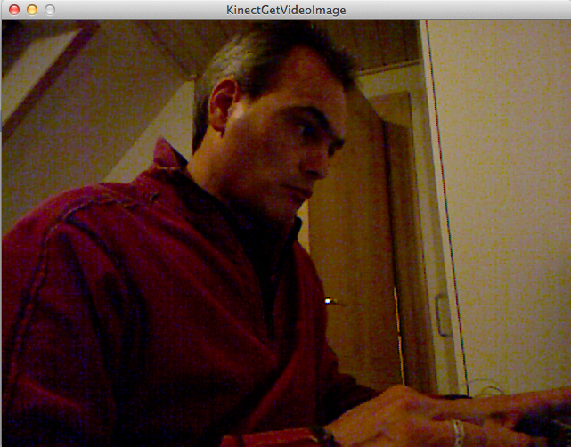
Capturing the RGB image
Enable RGB camera
Capture the current image from the Kinect video camera and display it just as you would display an ordinary image or a frame from a webcam
Stop the Kinect when you close the program overriding the stop callback. Remember to call super.stop() afterwards to make sure that the program stops normally.

Slide 8
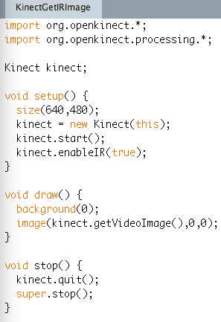
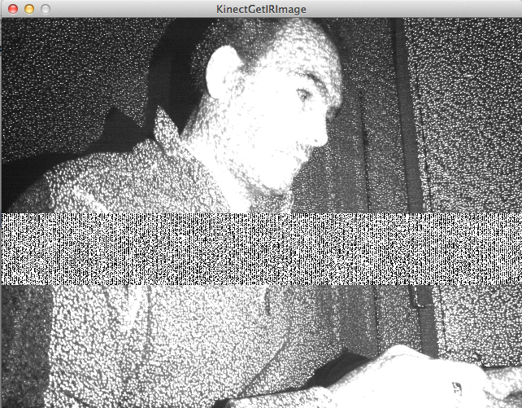
Capturing the IR image
Enable the IR camera
Use getVideoImage() to capture IR image. Both RGB and IR images use this function. The most recently enabled feed is shown.
Known bug in IR feed

Slide 9
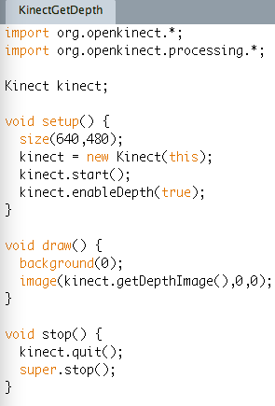
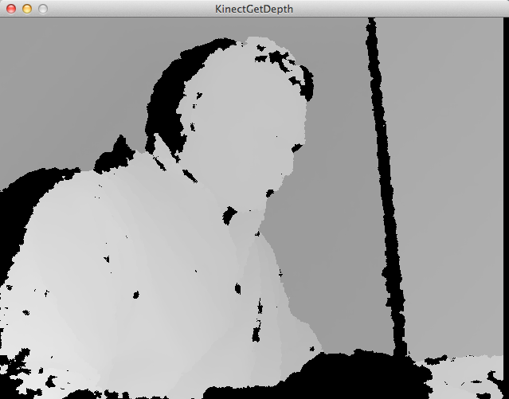
Capturing the depth image
Enable depth image
Request the depth image

Slide 10
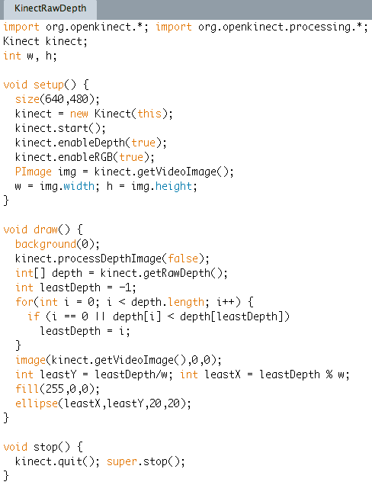
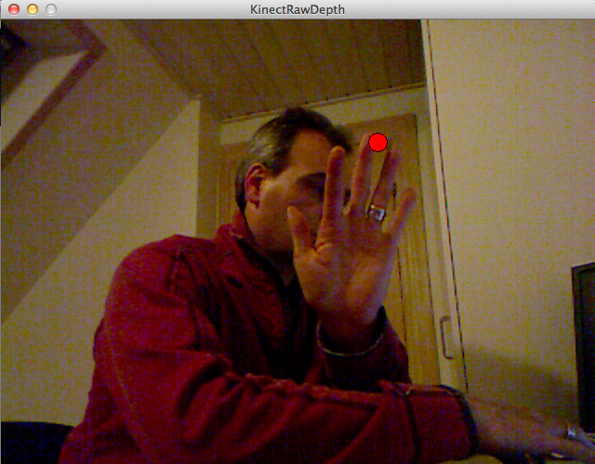
Getting the raw depth data
Enable depth to access depth data
Enable RGB to get video image and then find width and height of image
Disable depth image processing to speed things up
Get raw depth data
Find nearest point to sensor
Display RGB image
Find (x,y) co-ordinates of nearest point from depth int[] array

Slide 11
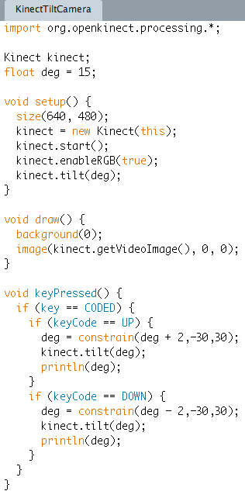
Tilting the camera
Use kinect.tilt(deg) to tilt the camera to deg degrees
Limits are approximately +/- 30 degrees
Can use keyPressed callback to detect key presses to change tilt
Use constrain() to keep tilt within limits
Use kinect.getVideoImage() to get the camera image

Slide 12
RGBDepthTest example
Demonstrates use of all the different channels

Slide 13
PointCloud
Uses 3D capabilities to draw points in space to construct a model of what the kinect depth sensor “sees”
The raw depth value can be translated into metres using the following formula
met = 1.0 / (rawDepth * -0.0030711016 + 3.3309495161)
Actually, you need to calibrate your own kinect to get precise values, but this should be good enough for most purposes

Slide 14
Average point tracking
Can use depth information for computer vision
e.g., “everything beyond 2m is “background” – ignore it!
Average point tracker computes centroid (2d mean position) of pixels in the scene nearer than a given threshold

Slide 15
More Kinect experiments
KinectExperiment01
Tracks nearest point in field of view
KinectExperiment02
Tracks n nearest points in field of view
KinectExperiment03
Tracks n nearest points and displays them on video capture image
KinectExperiment04
Tracks nearest point and tilts Kinect towards it

Slide 16
Using the Kinect with Processing in Windows
Try the CLNUI library – further information available here
http://www.pixelnerve.com/v/2010/11/19/clnui-4-java-kinect/

